Slide 1


Hackathon

Slide 2
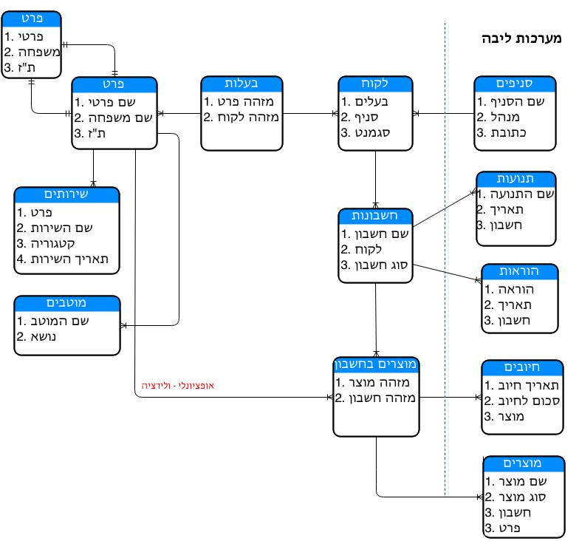
תרשים ישויות מערכת Salesforce

Slide 3
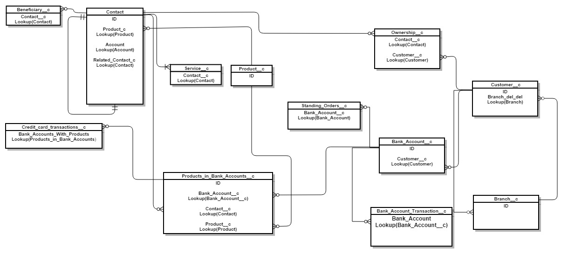
Entity Relationship Diagram

Slide 4
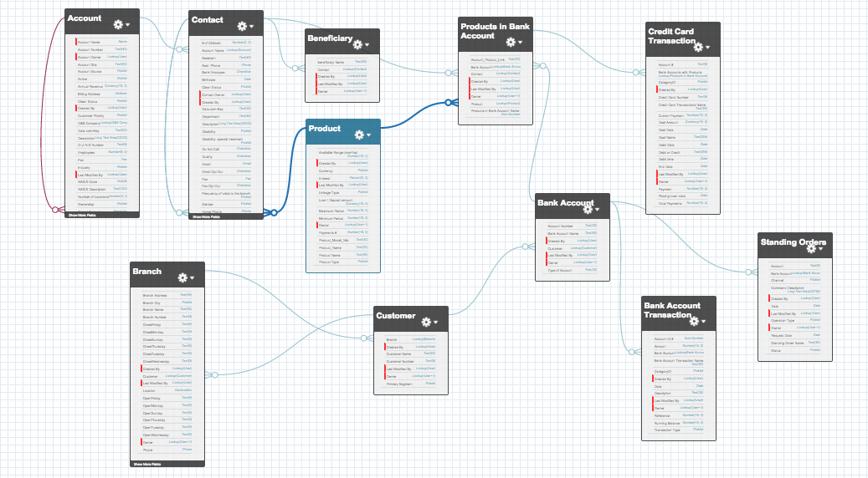
ERD
Go to Setup > Schema Builder to view it

Slide 5
Contact
Indicated a specific private person (First name, Last name, ID..)
Contact could be linked to another individual in favor of defining relationships between them (husband and wife, parents and children...)

Slide 6
Contact
Contact
ID
ISDELETED
ACCOUNTID
LASTNAME
FIRSTNAME
SALUTATION
NAME
OTHERSTREET
OTHERCITY
OTHERSTATE
OTHERPOSTALCODE
OTHERCOUNTRY
OTHERLATITUDE
OTHERLONGITUDE
MAILINGSTREET
MAILINGCITY
MAILINGSTATE
MAILINGPOSTALCODE
MAILINGCOUNTRY
MAILINGLATITUDE
MAILINGLONGITUDE
PHONE
FAX
MOBILEPHONE
HOMEPHONE

Slide 7
OWNERSHIP
A Table that links between a customer and a contact (creates a relationship between objects in many to many).

Slide 8
OWNERSHIP
Ownership
ID
CUSTOMER__C
CONTACT__C
OWNERID
ISDELETED
NAME
CREATEDDATE
CREATEDBYID
LASTMODIFIEDDATE
LASTMODIFIEDBYID
SYSTEMMODSTAMP
LASTACTIVITYDATE
LASTVIEWEDDATE
LASTREFERENCEDDATE

Slide 9

CUSTOMER
Gathering of individuals into an account (joining of individuals which own the account). Reflects an entity that can be owned by several accounts. (a customer can not be a customer in several branches, but he can have accounts in several branches).
There is a fixed threesome: Contact - Customer - Account. The customer entity is a unique value, underneath it is the Account List. Their can be a single contact or a collection of contacts.

Slide 10
Customer
Customer
ID
OWNERID
ISDELETED
NAME
CREATEDDATE
CREATEDBYID
LASTMODIFIEDDATE
LASTMODIFIEDBYID
SYSTEMMODSTAMP
LASTACTIVITYDATE
LASTVIEWEDDATE
LASTREFERENCEDDATE
CUSTOMER_NUMBER__C
PRIMARY_SEGMENT__C
BRANCH_DEL_DEL__C

Slide 11
BRANCH
A Branch of Bank Leumi is characterizes with address, ATM machine, and more... For the purpose of the Hackathon each branch has an ATM (The branch address is the address of the ATM).

Slide 12
Branch
Branches
ID
OWNERID
ISDELETED
NAME
CREATEDDATE
CREATEDBYID
LASTMODIFIEDDATE
LASTMODIFIEDBYID
SYSTEMMODSTAMP
LASTACTIVITYDATE
LASTVIEWEDDATE
LASTREFERENCEDDATE
BRANCH_ADDRESS__C
BRANCH_CITY__C
PHONE__C
LOCATION__LATITUDE__S
LOCATION__LONGITUDE__S
LOCATION__C
OPENSUNDAY__C
CLOSESUNDAY__C
OPENMONDAY__C
CLOSEMONDAY__C
OPENTUESDAY__C
CLOSETUESDAY__C
OPENWEDNESDAY__C
CLOSEWEDNESDAY__C
OPENTHURSDAY__C
CLOSETHURSDAY__C
OPENFRIDAY__C
CLOSEFRIDAY__C
CUSTOMER_RELATED__C
BRANCH_NUMBER__C

Slide 13
BANK ACCOUNT
A Financial Account at Bank Leumi. Each customer can have multiple bank accounts, their must be at least one bank account. An example of types of bank accounts: Current accounts, Deposits, Loans, Foreign exchange, Mortgage, Securities account, ILS Account, Dollar account, and more ...
Each account has only one client. Each account can have many Bank accounts.

Slide 14
Bank Account
Bank Accounts
ID
OWNERID
ISDELETED
NAME
CREATEDDATE
CREATEDBYID
LASTMODIFIEDDATE
LASTMODIFIEDBYID
SYSTEMMODSTAMP
LASTACTIVITYDATE
LASTVIEWEDDATE
LASTREFERENCEDDATE
TYPE_OF_ACCOUNT__C
ACCOUNT_NUMBER__C
CUSTOMER__C

Slide 15
PRODUCTS
Products that the bank sells to its customers. An example of the types of products: a loan (such as a mortgage-type) deposits (eg Short-term deposits), and more ...
Products are organized by affiliation to cataloged product families.

Slide 16
Products
Products
ID
OWNERID
ISDELETED
NAME
CREATEDDATE
CREATEDBYID
LASTMODIFIEDDATE
LASTMODIFIEDBYID
SYSTEMMODSTAMP
LASTACTIVITYDATE
LASTVIEWEDDATE
LASTREFERENCEDDATE
PRODUCT_TYPE__C
PRODUCT_MODEL_NBR__C
PRODUCT_NAME__C
INTEREST__C
LINKAGE_TYPE__C
CURRENCY__C
MINIMUM_PERIOD__C
MAXIMUM_PERIOD__C
LOAN_DEPOSIT_AMOUNT__C
AVAILABLE_RANGE_MONTHS__C
PAYMENTS__C

Slide 17
PRODUCTS IN BANK ACCOUNT
A connecting object, basing a many to many Relationship between Product and bank accounts.
one product can be linked to several bank accounts. A bank account can be linked to several products

Slide 18
Products In Bank Accounts
Products In Bank Accounts
ID
OWNERID
ISDELETED
NAME
CREATEDDATE
CREATEDBYID
LASTMODIFIEDDATE
LASTMODIFIEDBYID
SYSTEMMODSTAMP
LASTVIEWEDDATE
LASTREFERENCEDDATE
BANK_ACCOUNT__C
CONTACT__C
PRODUCT__C
ACCOUNT_PRODUCT_LINK__C

Slide 19
CREDIT CARD TRANSACTIONS
Credit card movements, Each billing entry is a line in this object

Slide 20
Credit Card Transactions
Credit Card Transactions
ID
OWNERID
ISDELETED
NAME
CREATEDDATE
CREATEDBYID
LASTMODIFIEDDATE
LASTMODIFIEDBYID
SYSTEMMODSTAMP
LASTACTIVITYDATE
LASTVIEWEDDATE
LASTREFERENCEDDATE
CREDIT_CARD_NUMBER__C
ACCOUNT__C
DEAL_DATE__C
DEAL_NAME__C
DEAL_AMOUNT__C
CATEGORYID__C
PAYMENT__C
TOTAL_PAYMENTS__C
CURRENT_PAYMENT__C
DEBIT_DATE__C
DEBIT_OR_CREDIT__C
BANK_ACCOUNTS_WITH_PRODUCTS__C
DEBIT_TIME__C
END_DATE__C
PLACING_LOAN_DATE__C

Slide 21
STANDING ORDERS
Authorization to debit. A Customer instructs the Bank to honor a demand for payment automatically for a certain body, and to transfer the required amount directly from his account.
In favor of the Hackathon event this table has no data. You can write into it as needed.

Slide 22
Standing Orders
Standing Orders
ID
OWNERID
ISDELETED
NAME
CREATEDDATE
CREATEDBYID
LASTMODIFIEDDATE
LASTMODIFIEDBYID
SYSTEMMODSTAMP
LASTACTIVITYDATE
LASTVIEWEDDATE
LASTREFERENCEDDATE
ACCOUNT__C
OPERATIONTYPE__C
DATE__C
CHANNEL__C
STATUS__C
BANK_ACCOUNT__C
REQUEST_DATE__C
COMMAND_DESCRIPTION__C

Slide 23
BANK ACCOUNT TRANSACTIONS
Movements in a particular bank account. For example, cash withdrawals, check withdrawal, transfer between accounts, Fees charged by the bank, taxes, and more ...

Slide 24
Bank Account Transactions
Bank Account Transactions
ID
OWNERID
ISDELETED
NAME
CREATEDDATE
CREATEDBYID
LASTMODIFIEDDATE
LASTMODIFIEDBYID
SYSTEMMODSTAMP
LASTACTIVITYDATE
LASTVIEWEDDATE
LASTREFERENCEDDATE
DATE__C
DESCRIPTION__C
TRANSACTION_TYPE__C
AMOUNT__C
REFERENCE__C
RUNNING_BALANCE__C
CATEGORYID__C
BANK_ACCOUNT__C
ACCOUNT_ID__C

Slide 25
BENEFICIARIES
Beneficiary on account. A Shortcut table for the benefit of the customer’s use of repetitive actions. For example, if a movement of money to a third party is a regular basis action, rather than fill out same form every time it would be possible to define the details of his beneficiary.
In favor of the Hackathon event this table has no data. You can write into it as needed.

Slide 26
Beneficiaries
Beneficiaries
ID
OWNERID
ISDELETED
NAME
CREATEDDATE
CREATEDBYID
LASTMODIFIEDDATE
LASTMODIFIEDBYID
SYSTEMMODSTAMP
LASTACTIVITYDATE
LASTVIEWEDDATE
LASTREFERENCEDDATE
CONTACT__C

Slide 27
SERVICES
Different Services that the bank offers the customer to choose to subscribe to them.
In favor of the Hackathon event this object will contains only two fields: name of the service and the individual which is linked to it.
Examples of possible services: receive messages in SMS, Green mail – receive documents by email instead of by mail, Internet subscription, Leumi-CALL).

Slide 28
Services
Services
ID
OWNERID
ISDELETED
NAME
CREATEDDATE
CREATEDBYID
LASTMODIFIEDDATE
LASTMODIFIEDBYID
SYSTEMMODSTAMP
LASTACTIVITYDATE
LASTVIEWEDDATE
LASTREFERENCEDDATE
CONTACT__C

